Slide 1
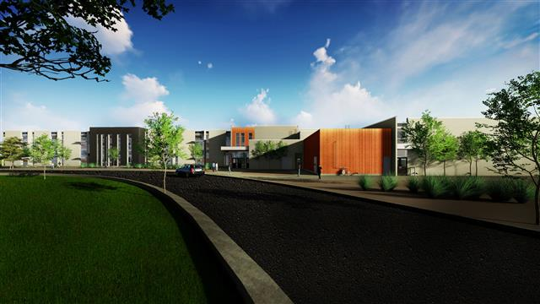

Welcome to Sky Ranch Middle School!
Blue Wing Squadron Parent Information

Slide 2

What is Blue Wing?

Slide 3

Team Policies
Be respectful – rights of other students, teachers, guests and school property.
Be prepared – come to class with appropriate materials.
Have a positive attitude – ready to learn and participate in class.
Be on time.

Slide 4
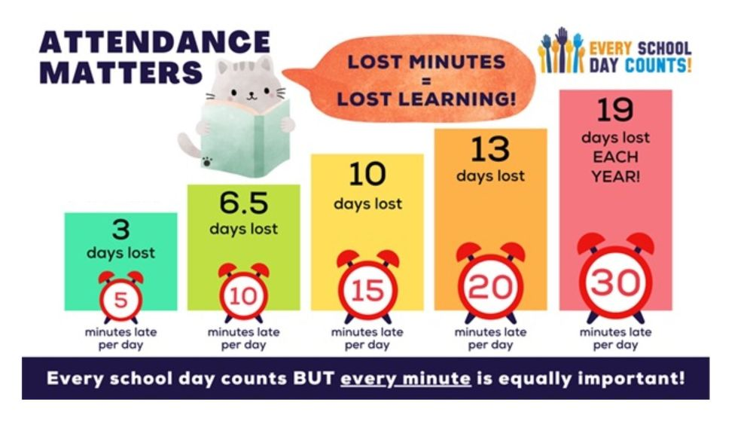
Attendance

Slide 5
Grading
Academic
Behavior
Classwork (15%)
Assessments (85%)
iReady (Math and ELA will count as 3%)
1 grade per week
Steps

Slide 6
iReady
Math and ELA only
40 minutes per week
20 minutes are completed in Enrichment
20 minutes are completed in class

Slide 7
Communication
Teacher emails
  Wallace – weekly
  Moffat – weekly
  Meadows – weekly
  De Leon – per unit

Slide 8
Cell Phones
Consequences Include…
1st Offense | No argument: cell phone is returned at the end of class. Student argues: phone is taken and turned into office. Parents/Guardians are contacted
2nd Offense: | Device is sent to the office for student pick up at the end of the day. Parents/Guardians are contacted
3rd Offense: | Device is sent to the office for parent/guardian pickup.
Phones in pocket chart at beginning of class

Slide 9
Sky Ranch SCHEDULES
Monday/Friday
1st Period | 7:30-8:20
2nd Period | 8:24-9:15
3rd Period | 9:19-10:09
4th Period | 10:13-11:03
Enrichment | 11:08-11:39
Lunch | 11:39-12:09
5th Period | 12:15-1:05
6th Period | 1:09-2:00
Wednesday- Early Release
1st Period | 7:30-8:13
2nd Period | 8:17-9:00
3rd Period | 9:04-9:47
4th Period | 9:51-10:34
Enrichment | 10:40-11:10
Lunch | 11:10-11:40
5th Period | 12:45-12:28
6th Period | 12:32-1:15
Tuesday/Thursday
6th Period | 7:30-8:20
5th Period | 8:24-9:15
4th Period | 9:19-10:09
3rd Period | 10:13-11:03
Enrichment | 11:08-11:39
Lunch | 11:39-12:09
2nd Period | 12:15-1:05
1st Period | 1:09-2:00

Slide 10
Enrichment
MONDAY: Grade Checks and Reading
TUESDAY: iReady - Math
WEDNESDAY: Second Step and SEL
THURSDAY: iReady - Reading
FRIDAY: Study Hall

Slide 11
Blue Wing
Website
www.washoeschools.net/bluewing
Contact information
Counseling Appointments

Slide 12
Infinite Campus
Infinite Campus (IC) is just a web-based grade book and will be updated weekly by the CORE teachers.
Please check IC each week to see if your child is missing any assignments.
  If the box for the score is blank, then the grade has not been entered.
  If it is marked missing, then it is counted as a 0% until it is turned in.
  Assessments 85%, classwork/homework/participation 15%
Parent Logins are the same as last year.
  If you have IC problems, contact the main office.
E-mail teachers directly with questions or concerns.
Students are encouraged to check Infinite Campus at least once a week

Slide 13
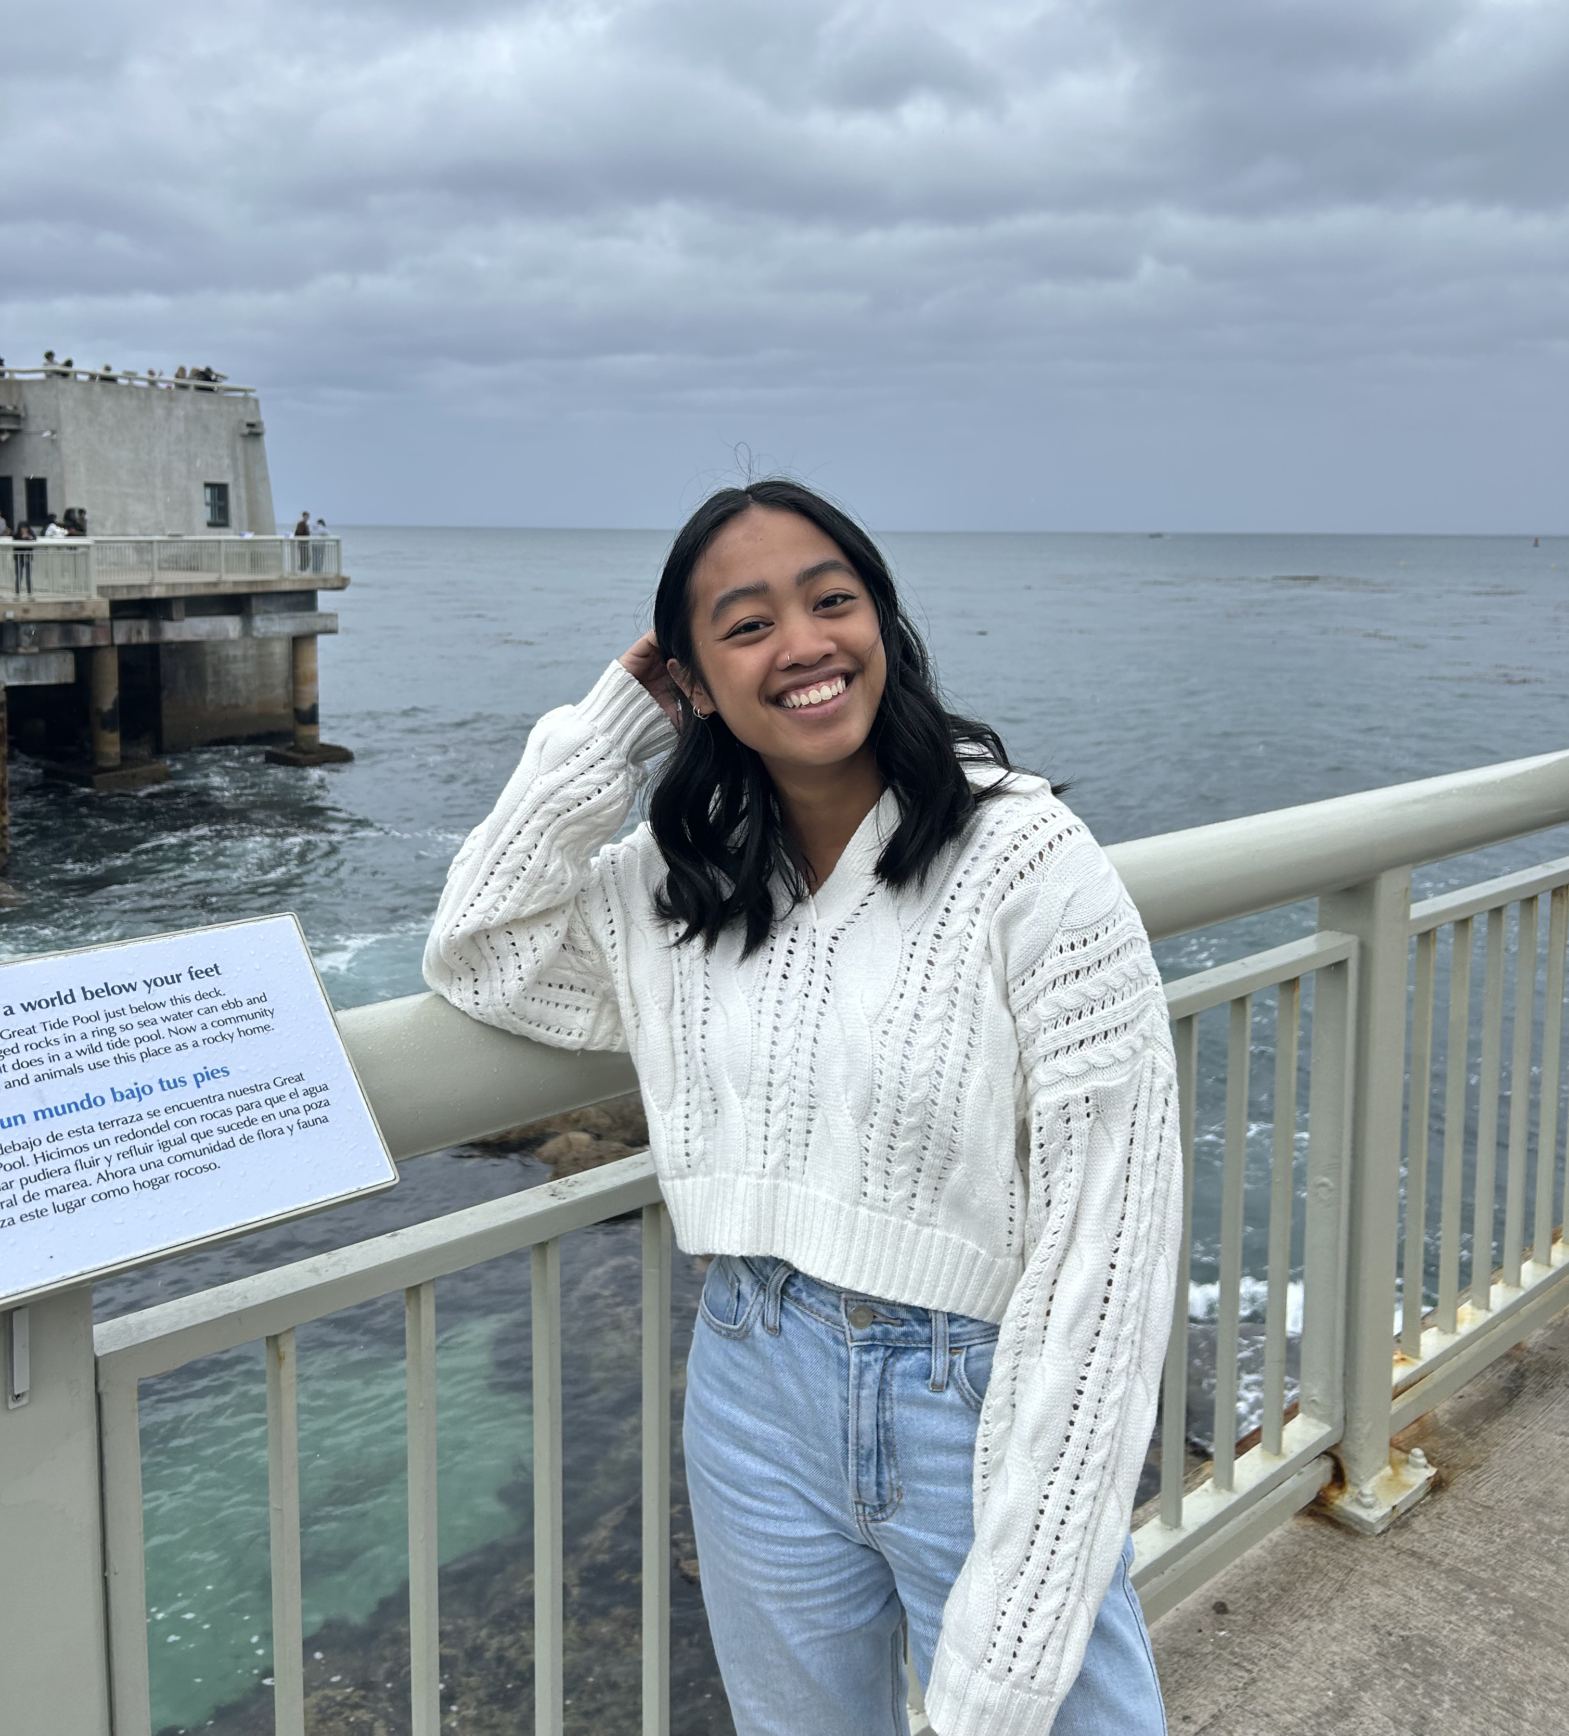
Ms. De Leon
7th Grade Science Units
Chemical Reactions & Matter
Chemical Reactions & Energy
Metabolic Reactions
Matter Cycling & Photosynthesis
Ecosystem Dynamics
Earth's Resources & Human Impact
The only material students will need to bring to class are their science notebooks, which we will use every day
  These notebooks can be kept in the classroom or brought home, but they need to have them every day to be successful

Slide 14
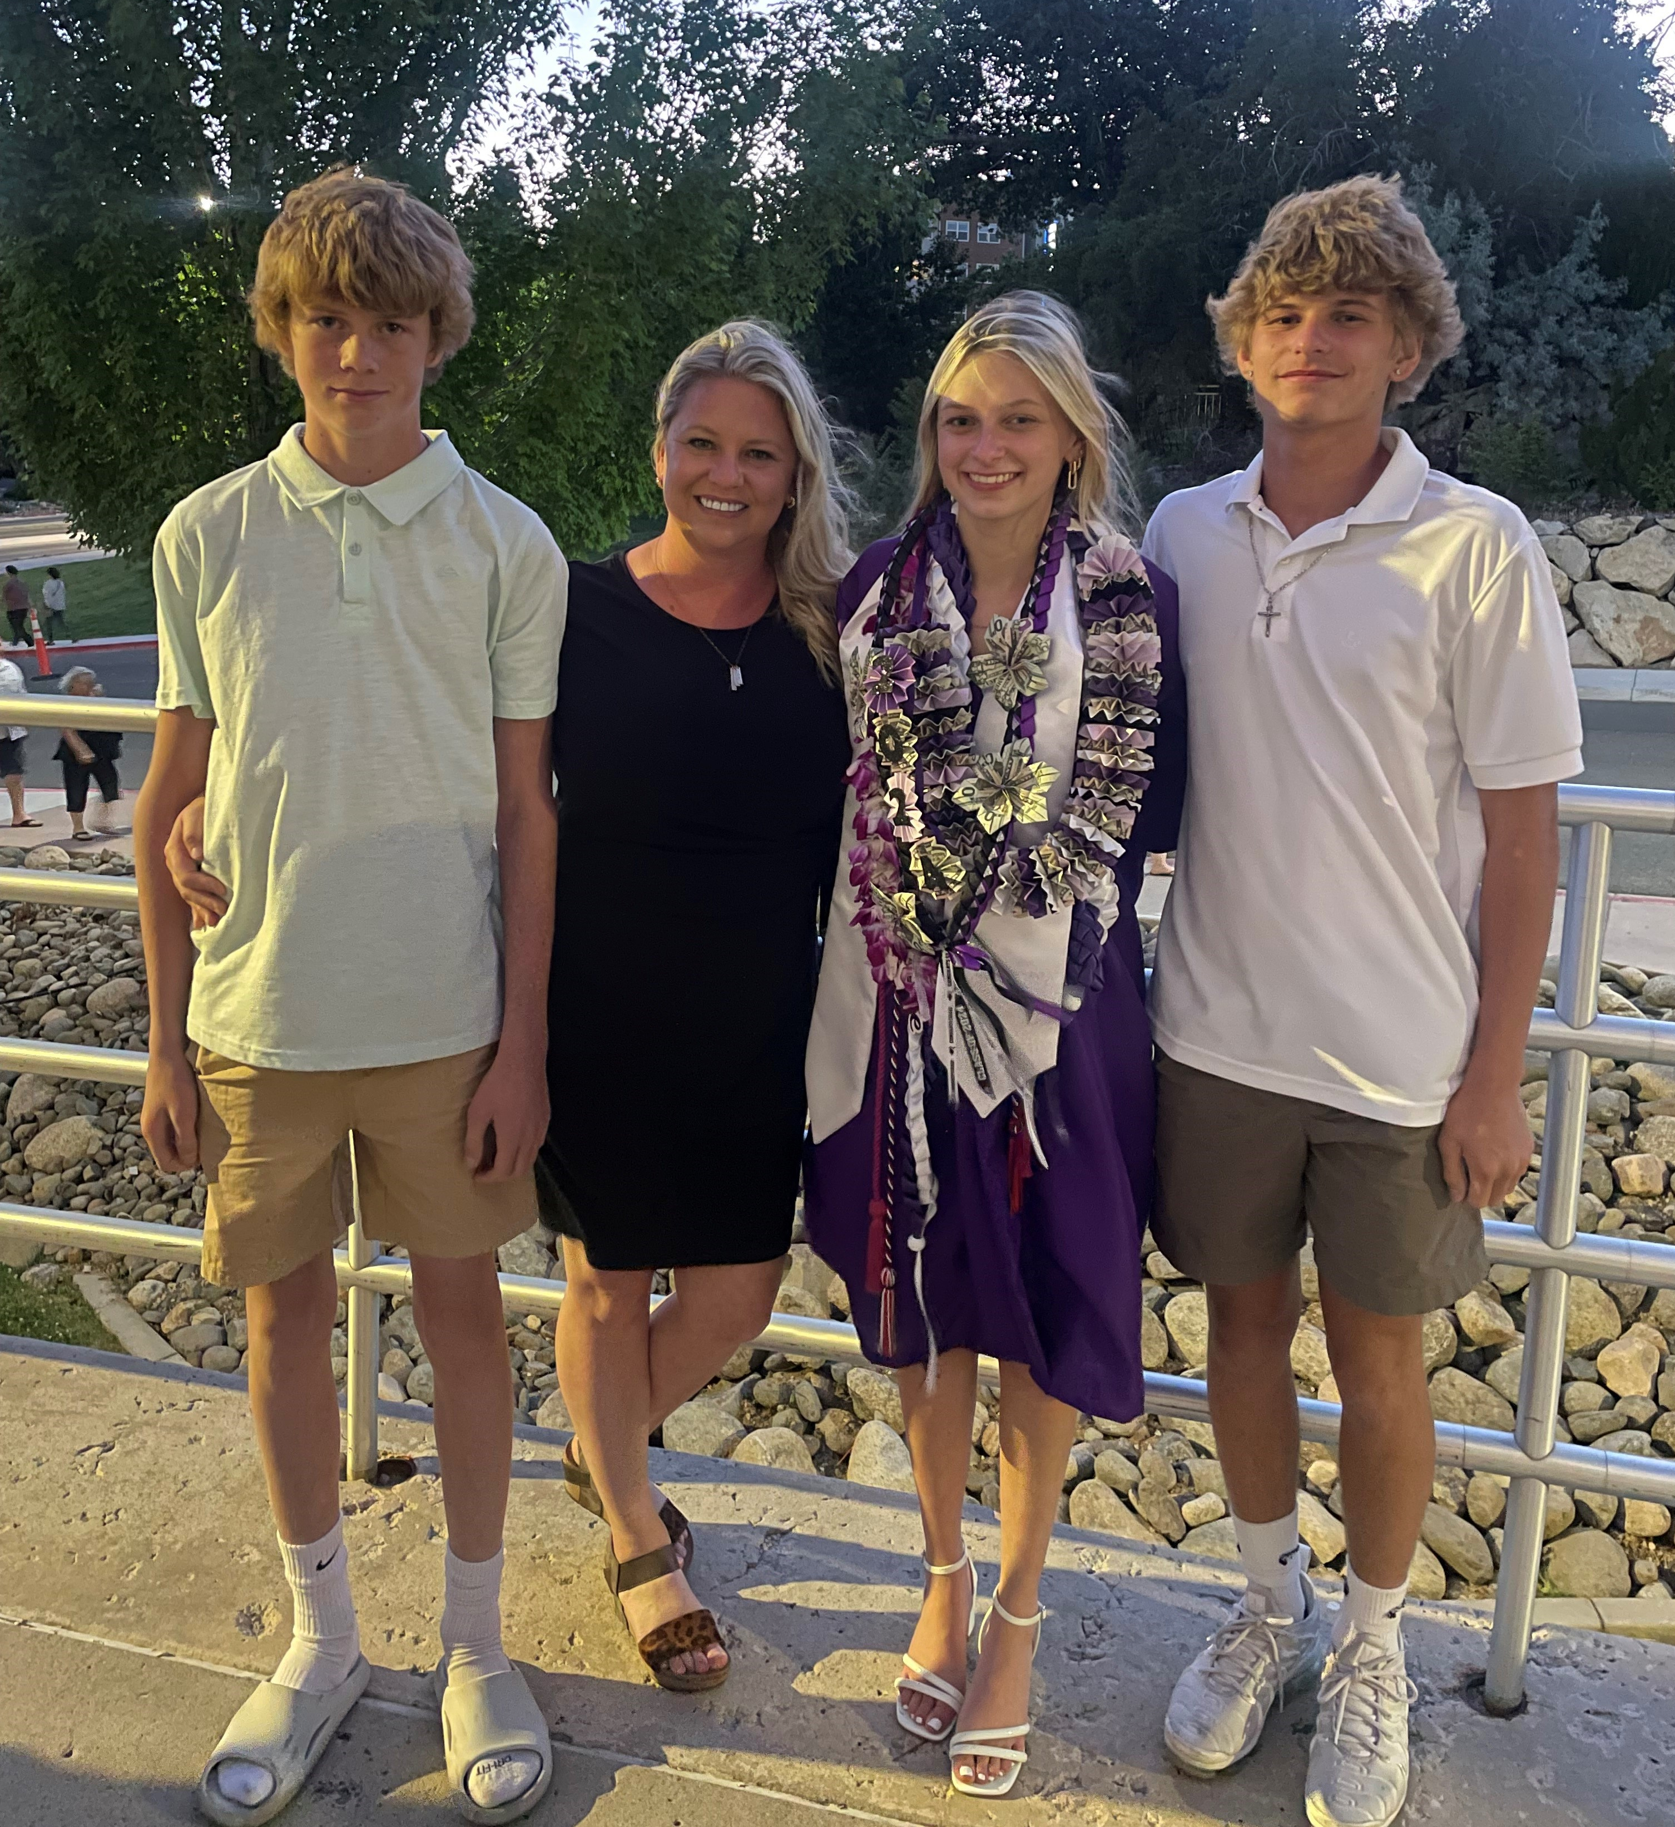
Ms. Meadows
Math 7/8/Math 8
Students use math binders daily-
  They need to be organized in the order we discussed in class. 1-Warmups, 2-Handouts, 3-Homework, 4-Assessments
We attempt to start homework in class, but whatever isn’t finished is homework.
Videos posted with EVERY lesson (found in Canvas)
Check IC frequently for behavior and academic grades
Emails are sent every Monday with agenda for the upcoming week. This also notes when they have homework. If I make a change that week and it affects any quiz/test I will email again.

Slide 15


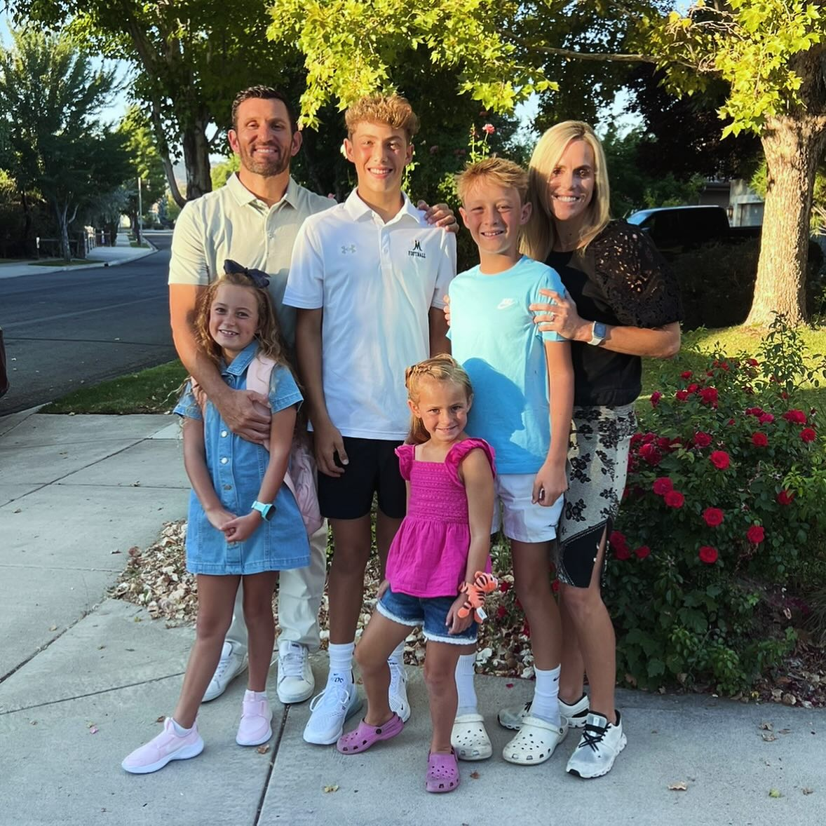
Skills-based instruction:
Analyze primary and secondary sources
Argumentative writing
Speaking/Listening
Real-world problem solving
^{7th} Grade Scope/Sequence:
First quarter: Revolution, Government
2nd Quarter: 28th Amendment project, Westward Expansion
3rd Quarter: Antebellum, Civil War
4th Quarter: Reconstruction, Frontier/Industry, Economics
Mr. Moffat
Social
Studies

Slide 16
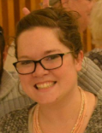

Mrs. Wallace
Homework:
Nightly reading
Quarter 1 – Short Stories and Narrative
Quarter 2 – Summary and Explanatory
Quarter 3 – Argument and Call of the Wild
Quarter 4 – Outsiders and Multimedia
Whole Class Novels:
Call of the Wild
Outsiders

Slide 17

ELA Co-Teacher: Mrs. Veluz maria.veluz@washoeschools.net
Math Co-Teacher: Mr. Cortez
John.Cortez@washoeschools.net
Resource Support

Slide 18
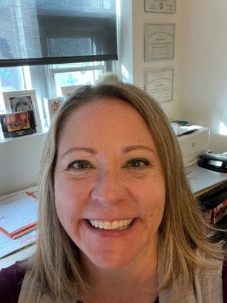
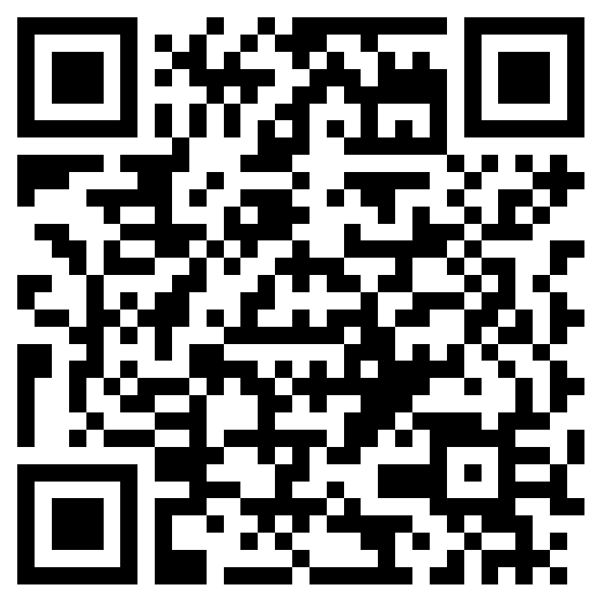
Mrs. Yost
7th grade counselor
School Counseling Services:
Classroom guidance lessons in Enrichment classes
Individual assistance – short term, solution-focused help (not therapy) for topics such as friend issues, academic concerns, big feelings
Referrals for outside of school therapy and other community supports for students and families
Meetings with parents, students and teachers for academic support
To schedule an appointment:
Scan the QR code and fill out the Form
Come to the Counselor Center and fill out the Form at the student aide desk
Go to the Sky Ranch website www.washoeschools.net/skyranch and click on Counselor Corner

Slide 19

Our Advice
Organization is #1 issue for struggling middle school students: Set aside 1 day per week to help your child get organized
Giving your child more responsibility is perfect, however, if they are not staying on top of things, micro-managing is not only just fine, but also recommended!

